Slide 1
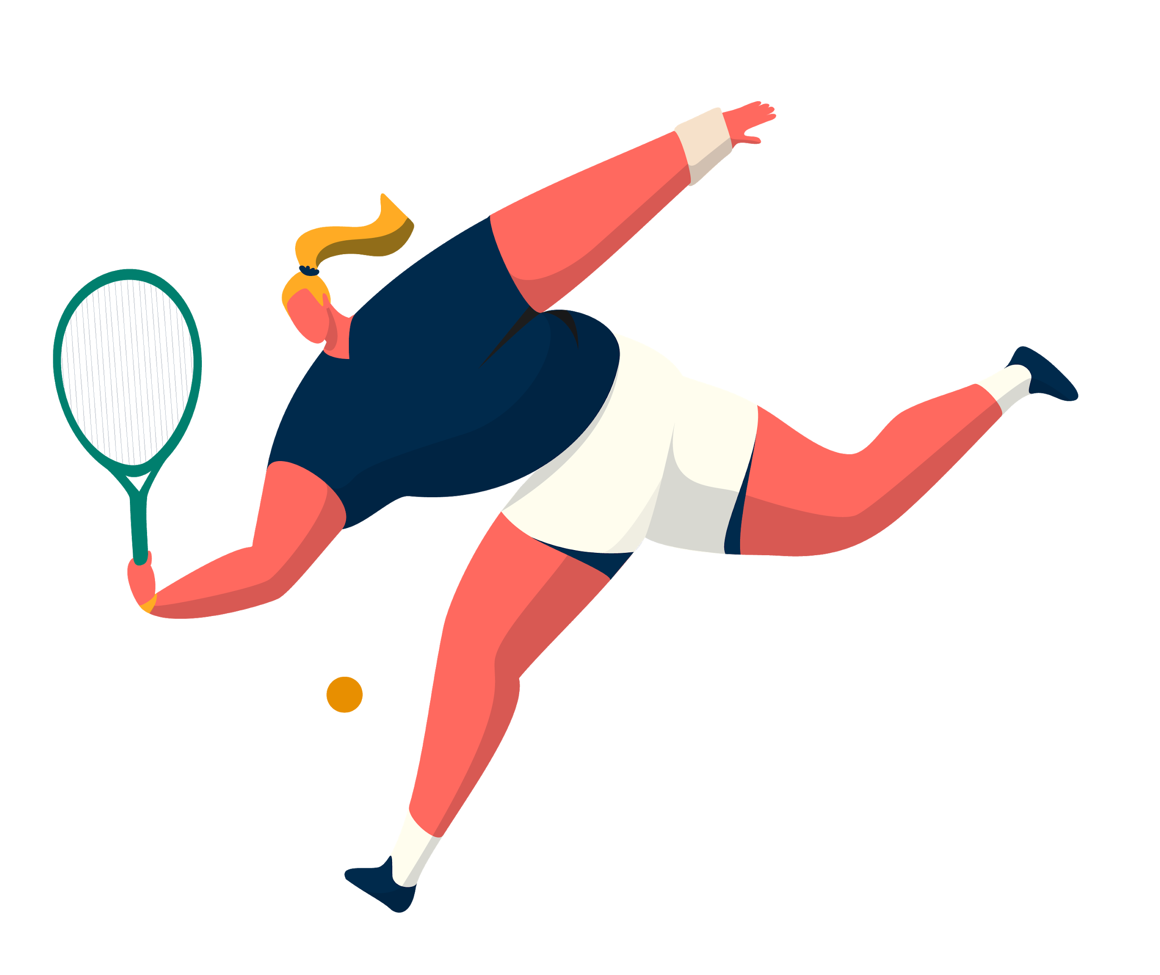
Mal3abak
Ashraf Al Jabari

Slide 2
01
Introduction
Why ?
02
TABLE OF CONTENTS
03
Used Technologies
04
Future Work

Slide 3
INTRODUCTION

Slide 4
WHY ?
Easier to find playgrounds
Getting to know new people to play with
Easier to schedule and keep track of bookings

Slide 5





Used Technologies

Slide 6



Future Work
Mobile App
Arabic Language
More Features

Slide 7
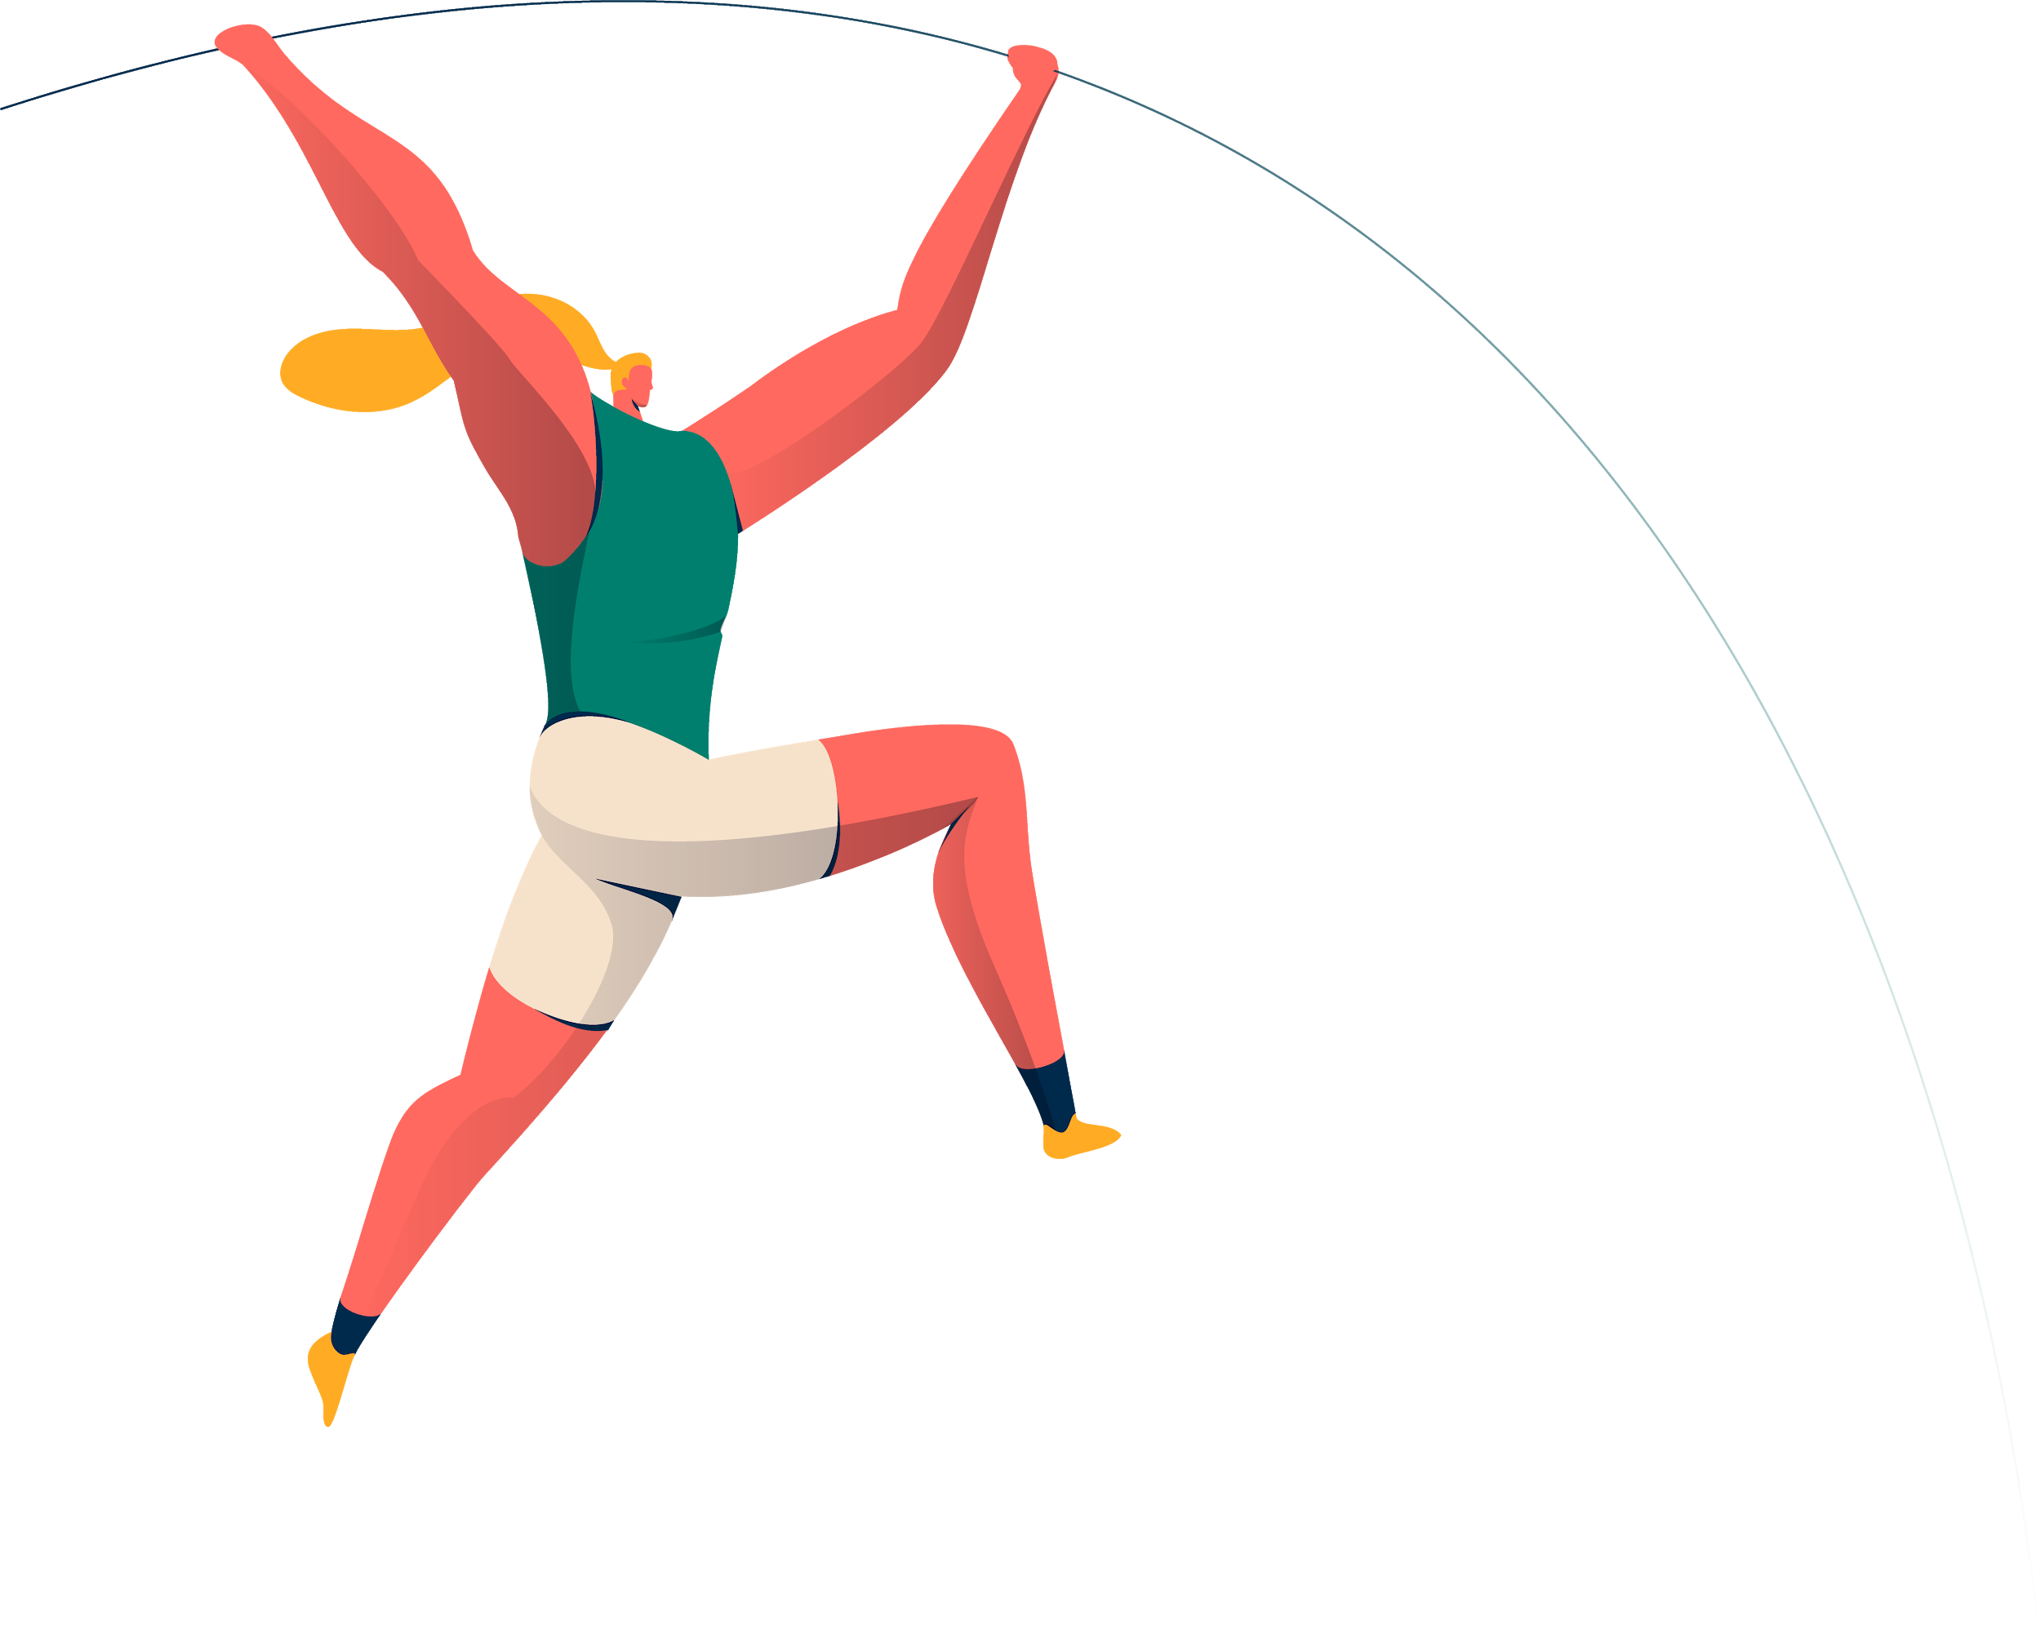
THANKS,
Website Demo

